Slide 1

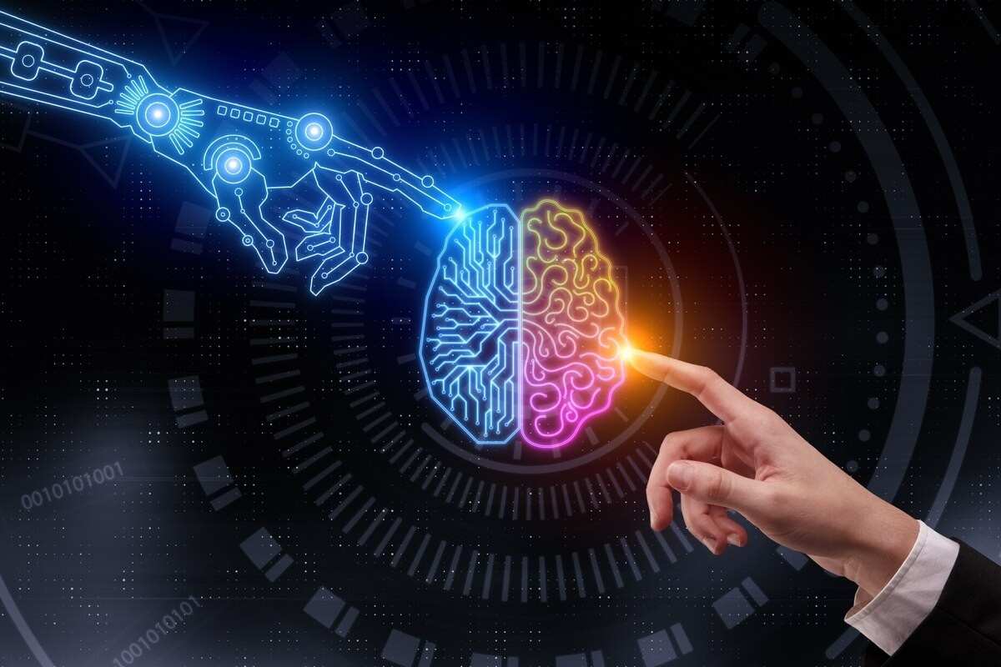
Introducción a la Inteligencia Artificial (IA)

Slide 2
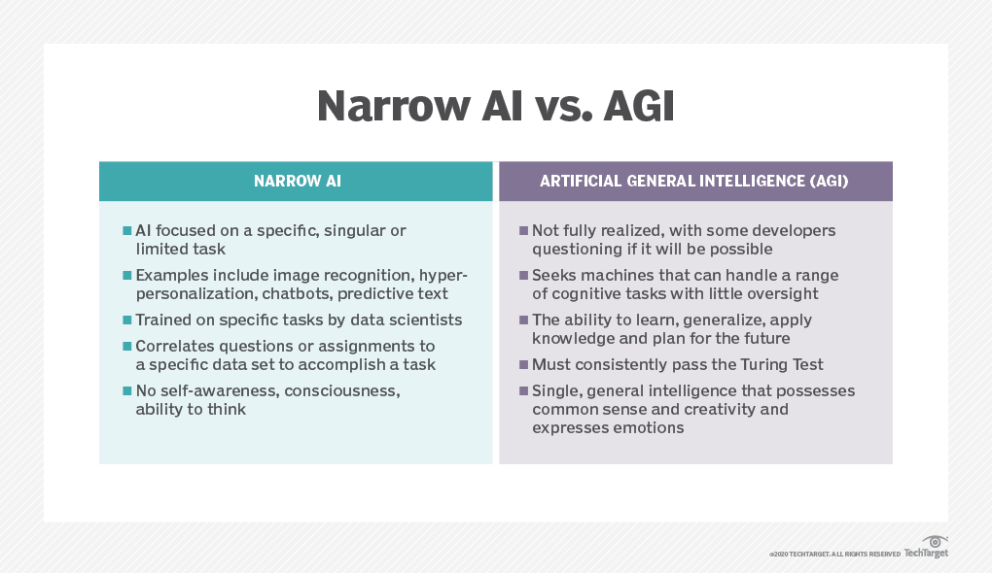
IA ESPECÍFICA vs IA GENERAL
https://towardsdatascience.com/what-is-artificial-general-intelligence-4b2a4ab31180

Slide 3
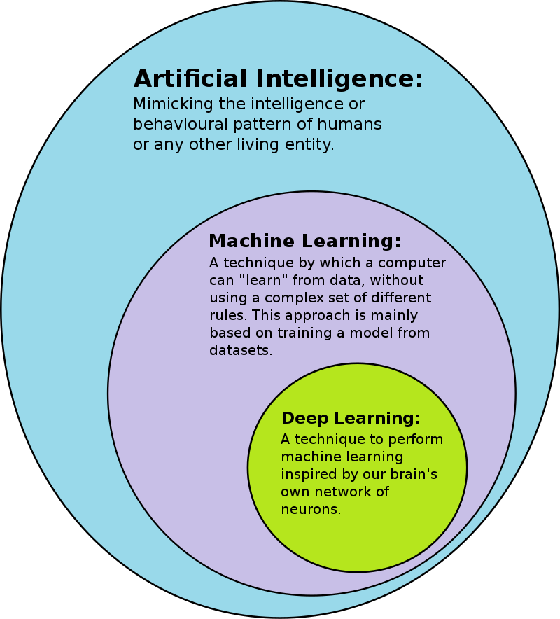
Machine Learning (ML) vs Deep Learning (DL)
https://en.wikipedia.org/wiki/Deep_learning

Slide 4
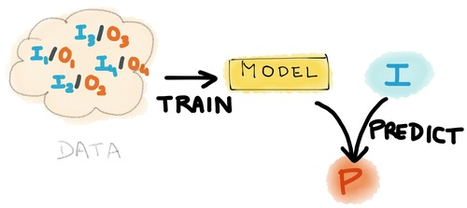
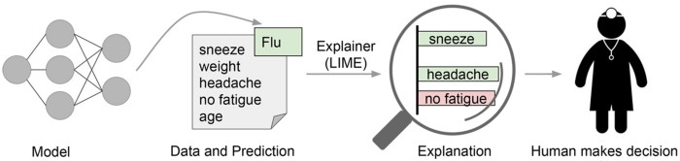
Predicción vs. Explicación
https://www.kdnuggets.com/2015/05/machine-learning-wars-amazon-google-bigml-predicsis.html
https://towardsdatascience.com/automating-interpretable-feature-engineering-for-predicting-clv-87ece7da9b36

Slide 5
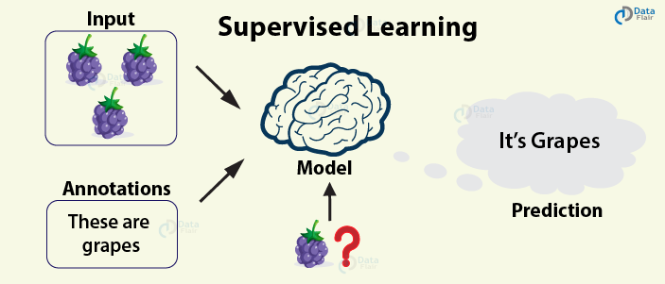
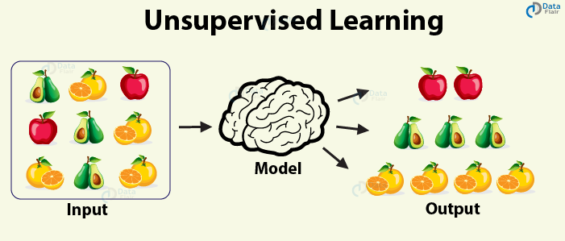
Aprendizaje supervisado vs no supervisado
http://projector.tensorflow.org/
https://data-flair.training/blogs/types-of-machine-learning-algorithms/

Slide 6
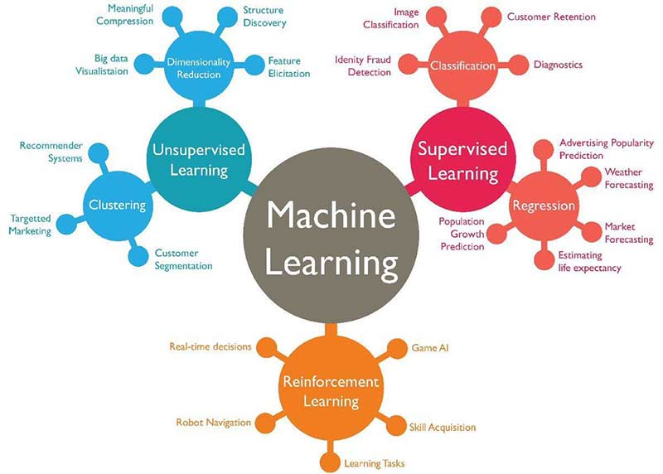
Tipos de modelos de ML
https://www.techleer.com/articles/203-machine-learning-algorithm-backbone-of-emerging-technologies/

Slide 7

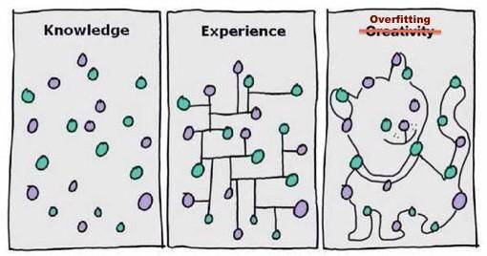
Overfitting vs. Underfitting
https://rubialesalberto.medium.com/qu%C3%A9-es-underfitting-y-overfitting-c73d51ffd3f9
https://algotrading101.com/learn/what-is-overfitting-in-trading/

Slide 8
Las 7+2 etapas de un proyecto de ML
DEFINIR EL PROBLEMA
Recopilar los datos
Prepara los datos (pre-proceso)
Seleccionar el modelo apropiado
Entrenar el modelo
Evaluar la calidad del modelo
Optimizar el modelo (ajuste de hiperparámetros)
Realizar predicciones
DESPLEGAR EL MODELO
https://towardsdatascience.com/the-7-steps-of-machine-learning-2877d7e5548e

Slide 9
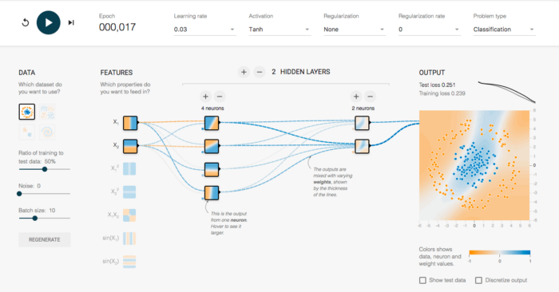
Tensorflow Playground

Slide 10
Ejemplos de aplicaciones de IA
https://teachablemachine.withgoogle.com/
http://projector.tensorflow.org/
https://quickdraw.withgoogle.com/
https://storage.googleapis.com/tfjs-models/demos/posenet/camera.html
https://www.tensorflow.org/tutorials/generative/style_transfer
https://www.youtube.com/watch?v=kopoLzvh5jY
https://medium.com/mlearning-ai/machine-learning-ai-bias-eb2b854a0f9d
https://www.telusinternational.com/articles/7-types-of-data-bias-in-machine-learning

